Slide 1
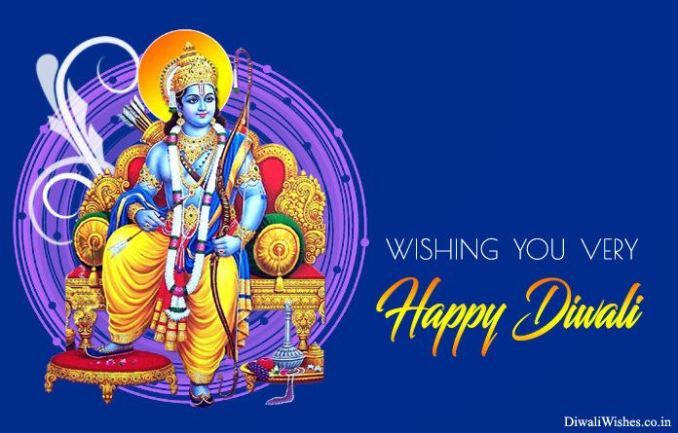

Slide 2
Abitha’s dance

Slide 3
Talk show

Slide 4
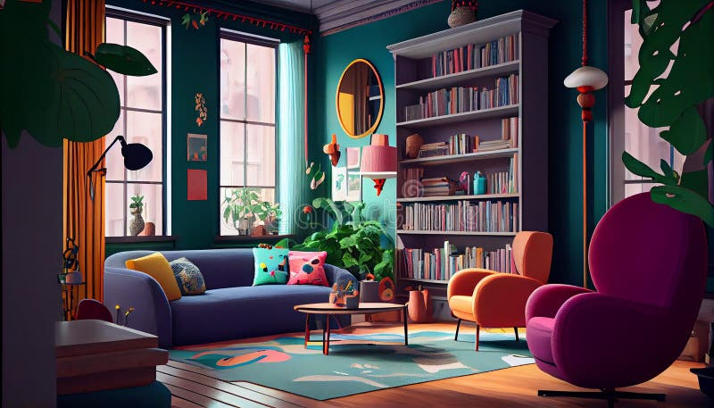
Notes:
Diwali skit part 1

Slide 5
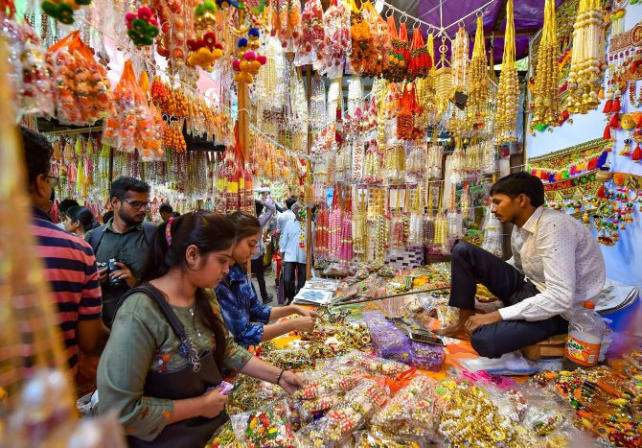
Notes:
Diwali skit part 2

Slide 6
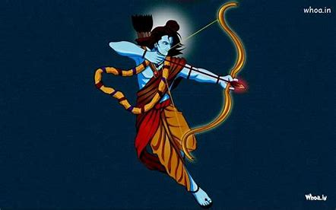

Slide 7
Ramayana skit

Slide 8
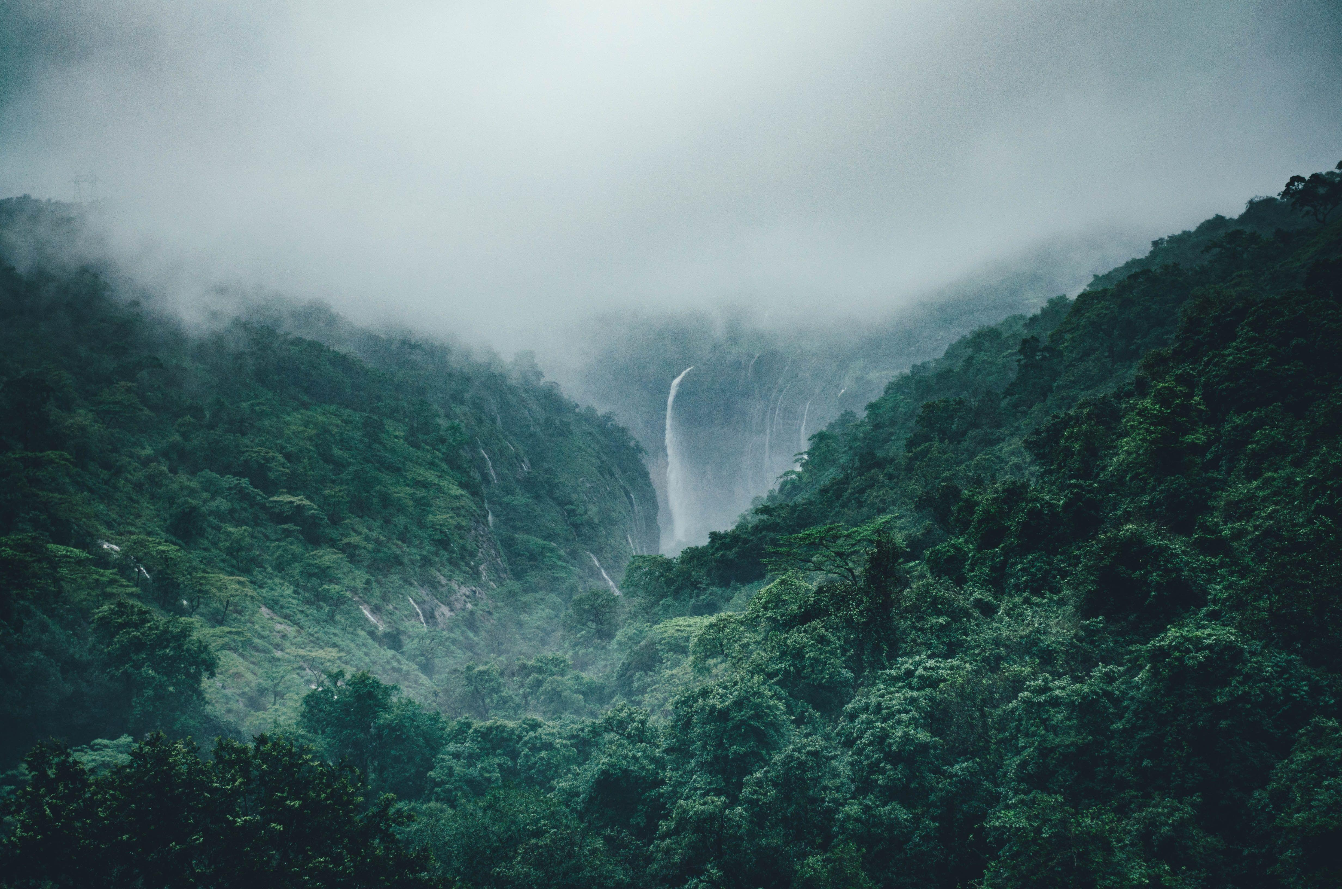
Notes:
Govardhan Skit

Slide 10
